Slide 1

Notes:
1st slide (Mandatory)

Slide 2

Kruskal's Algorithm
Kruskal algorithm is another most important algorithm used for Minimum Spanning Tree.
MST is a spanning tree having a weight less than or equal to the weight of every spanning tree.
Kruskal algorithm in Java takes a connected and undirected graph and returns the Minimum Spanning Tree of it.
Topic/Course

Slide 3
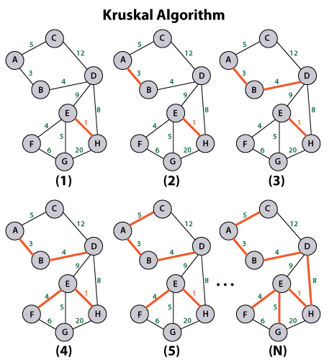

Slide 4
import Java.util.*;
minimum spanning tree of the given graph
class KruskalAlgorithm {
class Edge implements Comparable<Edge> {
int source, destination, weight;
public int compareTo(Edge edgeToCompare) {
return this.weight - edgeToCompare.weight;
} };
class Subset {
int parent, value;
};
int vertices, edges;
Edge edgeArray[];
KruskalAlgorithm(int vertices, int edges) {
this.vertices = vertices;
this.edges = edges;
edgeArray = new Edge[this.edges];
for (int i = 0; i < edges; ++i)
edgeArray[i] = new Edge();
}
void applyKruskal() {
Edge finalResult[] = new Edge[vertices];
int newEdge = 0;
int index = 0;
for (index = 0; index < vertices; ++index)
finalResult[index] = new Edge();
Arrays.sort(edgeArray);
Subset subsetArray[] = new Subset[vertices];
for (index = 0; index < vertices; ++index)
subsetArray[index] = new Subset();

Slide 5
for (index = 0; index < newEdge; ++index)
System.out.println(finalResult[index].source + " - " + finalResult[index].destination + ": " + finalResult[index].weight); }
int findSetOfElement(Subset subsetArray[], int i) {
if (subsetArray[i].parent != i)
subsetArray[i].parent = findSetOfElement(subsetArray, subsetArray[i].parent);
return subsetArray[i].parent;
}
void performUnion(Subset subsetArray[], int sourceRoot, int destinationRoot) {
int nextSourceRoot = findSetOfElement(subsetArray, sourceRoot);
int nextDestinationRoot = findSetOfElement(subsetArray, destinationRoot);
if (subsetArray[nextSourceRoot].value < subsetArray[nextDestinationRoot].value)
subsetArray[nextSourceRoot].parent = nextDestinationRoot;
for (int vertex = 0; vertex < vertices; ++vertex) { subsetArray[vertex].parent = vertex; subsetArray[vertex].value = 0; } index = 0; while (newEdge < vertices - 1) { Edge nextEdge = new Edge(); nextEdge = edgeArray[index++]; int nextSource = findSetOfElement(subsetArray, nextEdge.source); int nextDestination = findSetOfElement(subsetArray, nextEdge.destination); if (nextSource != nextDestination) { finalResult[newEdge++] = nextEdge; performUnion(subsetArray, nextSource, nextDestination); } }

Slide 6

THANK YOU

